Slide 1
420-517-DW Software Development Project – Java III
Version Control Basics

Slide 2
Why Do We Need Version Control/Revision Control/Source Control
Backup and Restore
Synchronization
Short-term undo
Long-term undo

Slide 3
Why Do We Need Version Control/Revision Control/Source Control
Track Changes
Track Ownership
Branching and merging

Slide 4
Terminology
Repository (repo)
Server
Client
Working Set/Working Copy
Trunk/Main

Slide 5
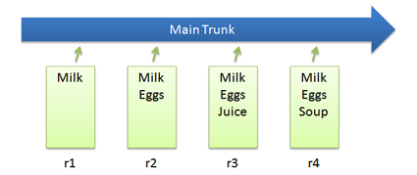
Check In
Check in a file as it is modified over time

Slide 6
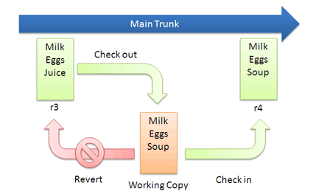
Checkout – Edit – Check In
Checkout the file before every change

Slide 7
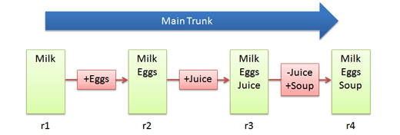
Diffs
Changes made while editing

Slide 8
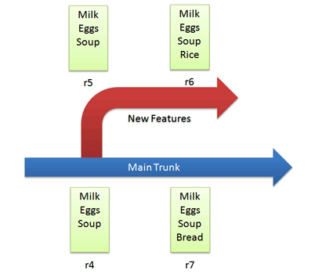
Branching
Copies code into a separate folder
Save as . .

Slide 9
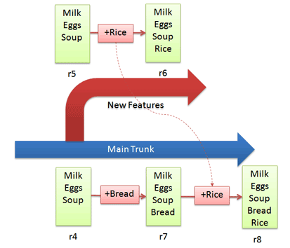
Merging

Slide 10
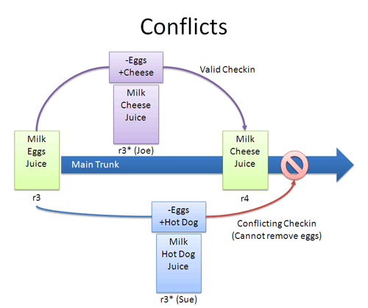
Conflicts
Arise when changes appear that don’t gel

Slide 11
Resolving Conflicts
When changes overlap and contradict:
Re-apply your changes
or
Override their changes with yours

Slide 12
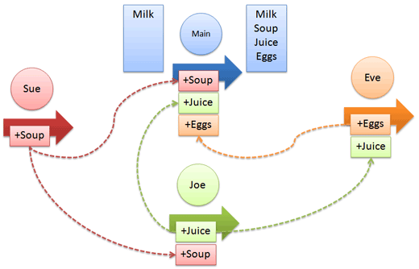
Distributed Version Control Systems
Every developer has their own repo
If desired, everyone can push changes into a common repo

Slide 13
Bibliography
http://betterexplained.com/articles/a-visual-guide-to-version-control/

